Slide 1
USED CAR PRICE/QUALITY CLASSIFICATION Presentation

Slide 2
Project analysis slide 2
Project Analysis
PROBLEM STATEMENT…………
FEATURE SELECTION
PROJECT
DATA INSIGHTS ……
MODEL SELECTION
DATA PREPROCESSING ………
MODEL DEVELOPMENT

Slide 3
Project analysis slide 2
Problem Statement
The Manheim Used Vehicle Index, clearly illustrates that more than 5 million used-vehicle sales each year
People experience a hard row to hoe in purchasing desired featured second-hand car within the targeted budget and they play it by ear multiple times.
It is hard to decide whether used car is fraudulent or not?
Dataset →

Slide 4




Project analysis slide 3
Data Insights
ECONOMIC FACTORS
DATA COLLECTION
RULE OF THUMB
TARGET VALUES
DATASET INSIGHTS
WHAT DATA CONTAINS?
The relative strength of the economy, both globally and in the United States specifically, indirectly influences the value of your car and the overall state of the used-car market.
Odometer : between 0 to 469000
Year: between 1927 to 2020
Make: 39 companies car data
Model: each companies models
This data was collected manually from observations to build machine-learning models to predict the quality of the car.
A Rule of thumb is that customers aim to buy a low to average-priced car having desired features.
Target values are in terms of price represented as cheap(0), average(1), or high(2).
It had no missing values but contained a lot of noisy data, so it was quite difficult to decide whether to delete or include the attributes.

Slide 5
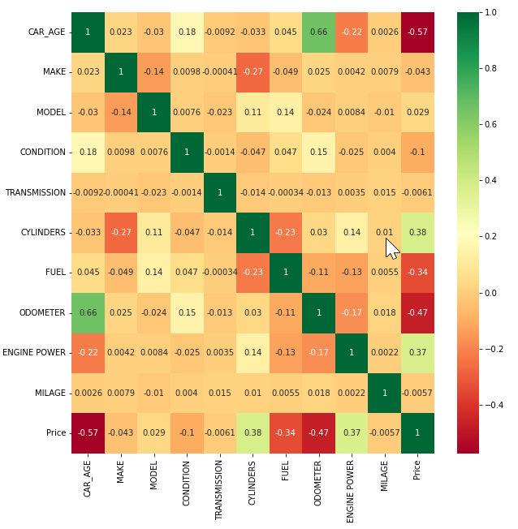
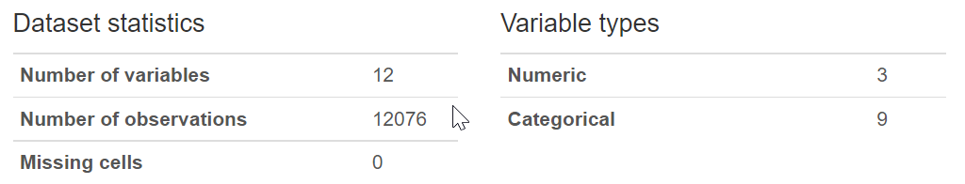
Project analysis slide 3
Data Insights

Slide 6
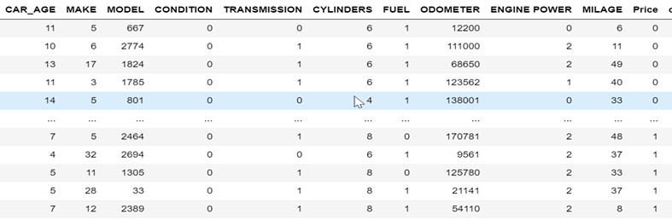
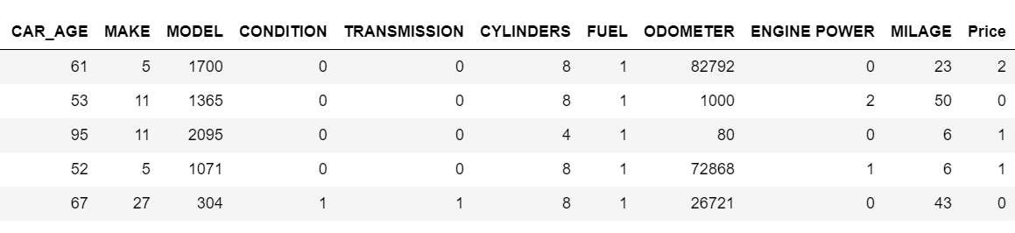
Project analysis slide 4
Data Preprocessing
Used LabelEncoder() in Python to convert Categorical values to Numeric values.
For every attributes we encoded its categorical values
Removed the data of the car whose age was high.
Some of the car’s odometer rating were quite low, so it seems that the data was fraudulent.

Slide 7
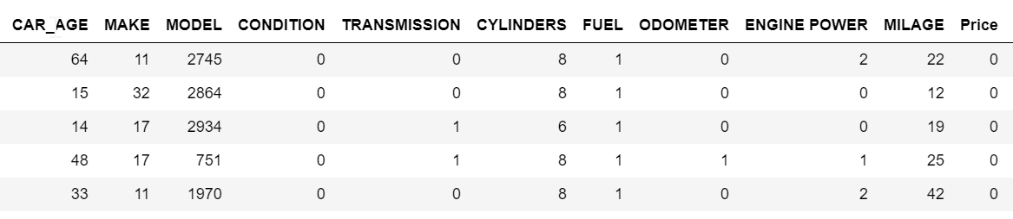
Project analysis slide 4
Data Preprocessing
Since, car age was greater than 2 and odometer reading was less than 100, we dropped this data in order to classify the actual data accurately.
The number of columns that dropped were around 85.

Slide 8
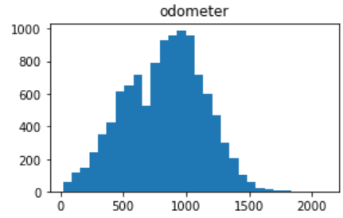
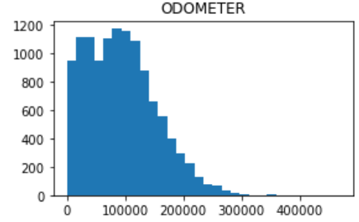
Project analysis slide 4
Data Preprocessing
Since, the odometer reading was left skewed, we normalized the data by using Box-Cox Transformation and Skew method.
This was done to normalize the data.

Slide 9
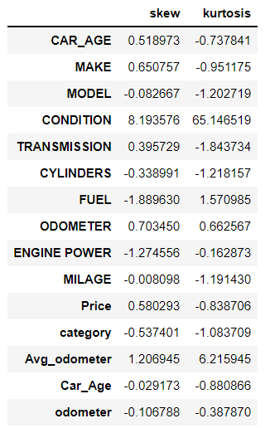
Project analysis slide 4
Data Preprocessing
The picture shows the skewness value and kurtosis value of each of the attributes of the dataset.

Slide 10




Project analysis slide 6
Feature Selection
Eliminates redundant variables
They are highly accurate.
Reduces overfitting
Reduces Training Time
Reduce the computational cost of modeling
Improves accuracy of the model

Slide 11
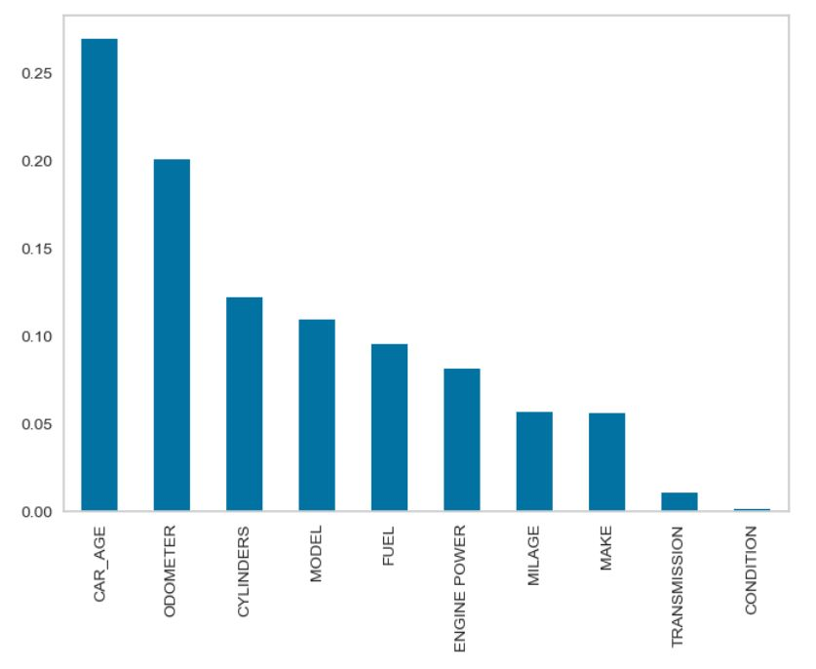
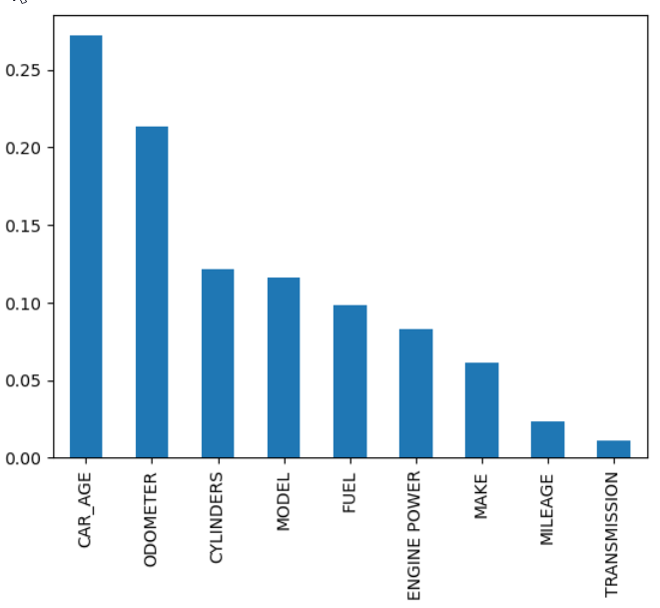
Project analysis slide 6
Feature Selection
We used Random Forest Algorithm to do feature selection.
We dropped ‘Condition’ attribute as it was showing no importance.
After normalizing the ‘Odometer’, it was observed that, it provided more importance than not normalizing.

Slide 12
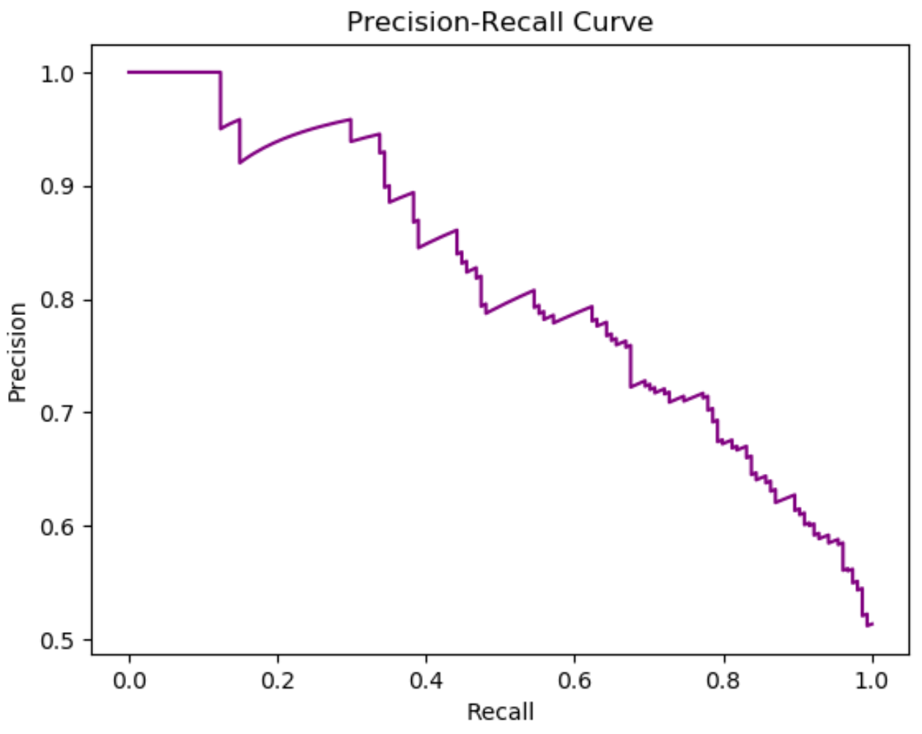
Project analysis slide 5
Model Selection
Criteria
CONFUSION MATRIX FOR 3 CLASSES
TN | FP | TN
FN | TP | FN
TN | FP | TN
PRECISION
RECALL
F1 SCORE
TN / (TN + TP)
TP / (TP + TN)
2( PRECISION * RECALL)
( PRECISION + RECALL)

Slide 13
Project analysis slide 8
Model Development
K NEAREST NEIGHBOR
DECISION TREE
KNN is one of the simplest machine learning algorithms.
KNN helps to classify the new data points based on the similarity measure of the earlier stored data points.
Decision trees do not require feature scaling.
Trees can provide the feature importance or how much each feature contributed to the model training results.
Decision trees do not require feature scaling
Cat Boost is based on gradient boosted decision trees. During training, a set of decision trees is built consecutively.
Each successive tree is built with reduced loss compared to the previous trees.
It is fast and handle categorical data smoothly.
Light GBM grows tree vertically while other algorithm grows trees horizontally meaning that Light GBM grows tree leaf-wise while another algorithm grows level-wise.
Faster training speed, higher efficiency and reduce memory usage.
CAT BOOST CLASSIFIER
LIGHT GRADIENT BOOSTING CLASSIFIER

Slide 14
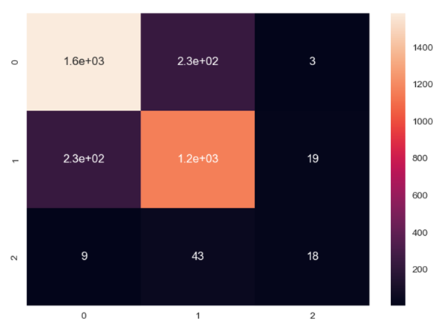
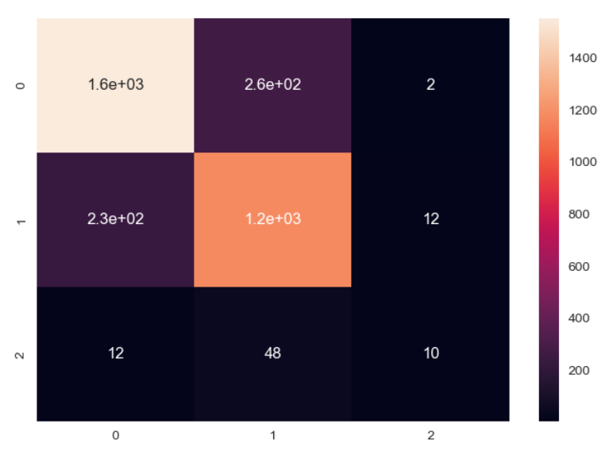
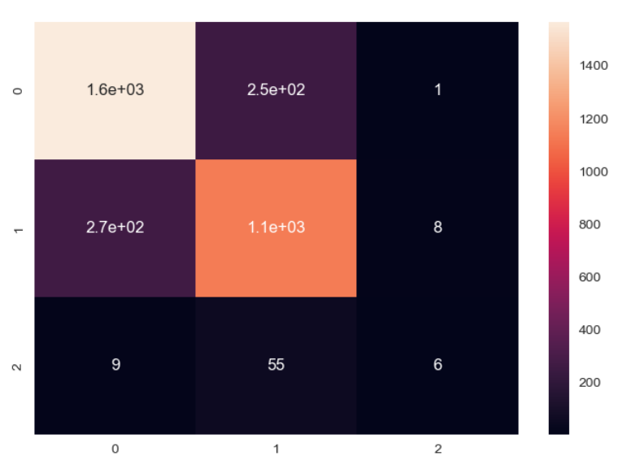
Project analysis slide 10
K NEAREST NEIGHBOR
We tried to use different values of ‘K’ and generated different confusion matrix. The value of ‘K’ used are 3, 5, 7.
Confusion Matrix for K = 3
Confusion Matrix for K = 5
Confusion Matrix for K = 7

Slide 15
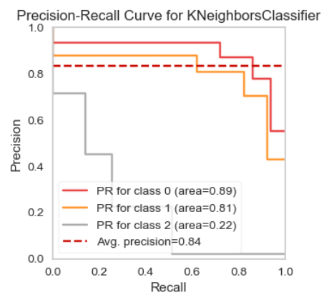
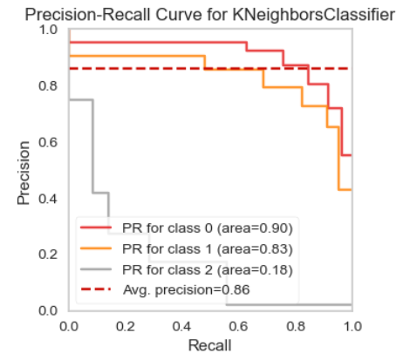
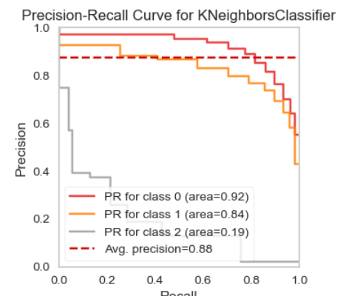
Project analysis slide 10
K NEAREST NEIGHBOR
We tried to use different values of ‘K’ and generated different confusion matrix. The value of ‘K’ used are 3, 5, 7.
Precision – Recall Curve for K = 3
Precision – Recall Curve for K = 5
Precision – Recall Curve for K = 7
K = 3 has shown better results in terms of Accuracy and Precision in compared to other values of K. But AUC for KNN was quite low for ‘Class 2’.

Slide 16
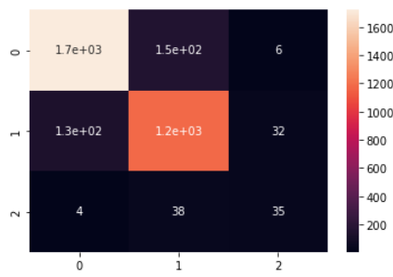
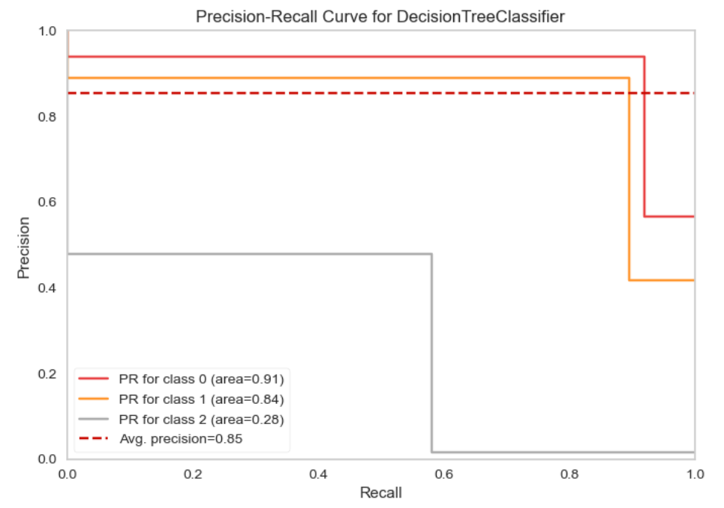
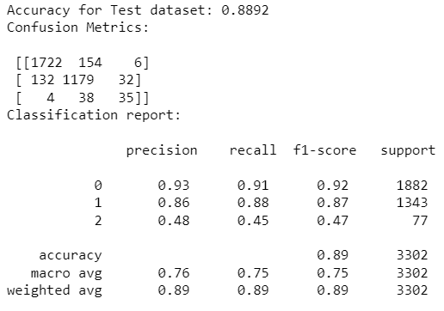
Project analysis slide 10
DECISION TREE
Using Decision Tree Algorithms, we got an Accuracy of 88.92%. But AUC for this algorithm was low for ‘Class 2’, but better than KNN.

Slide 17
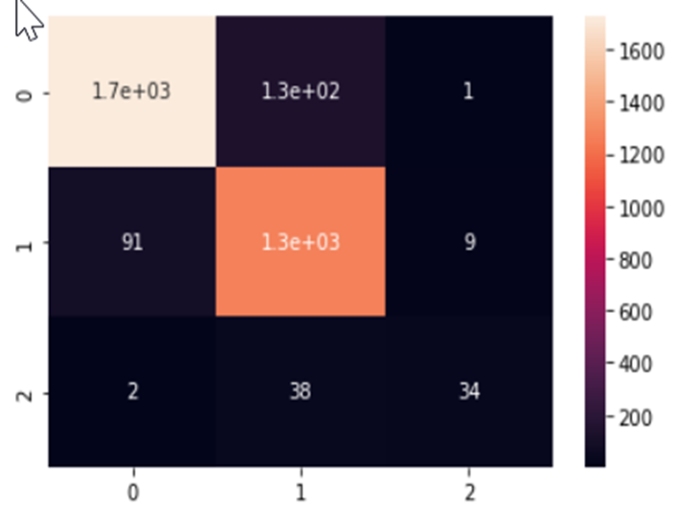
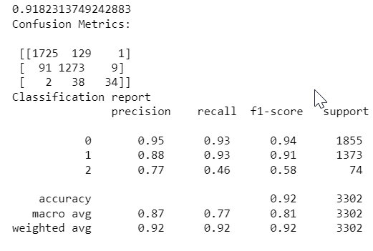
Project analysis slide 10
CAT BOOST CLASSIFIER
Using Cat Boost Classifier, we got an Accuracy of 91.82%.

Slide 18
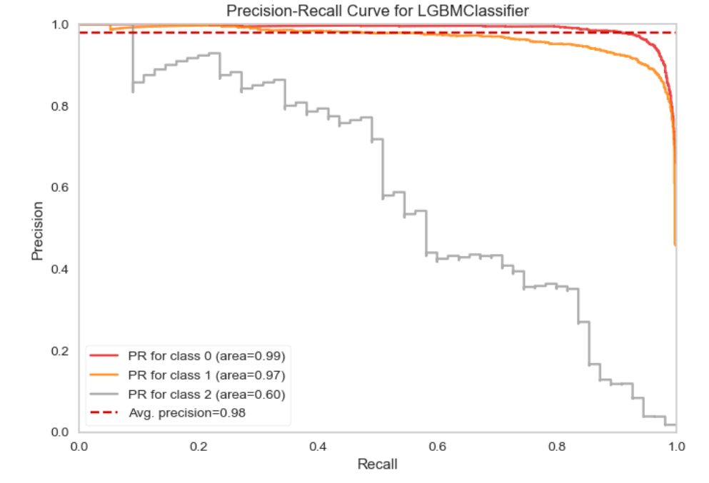
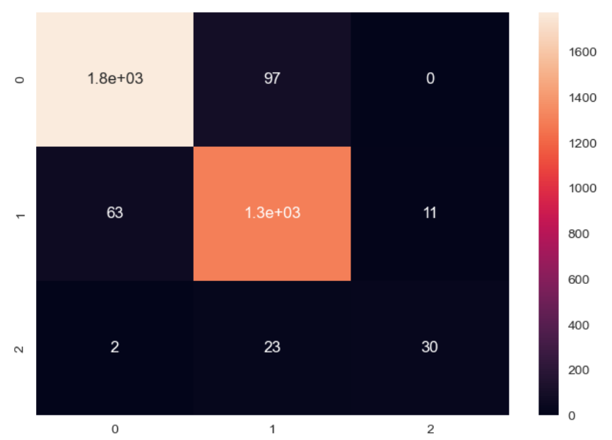
Project analysis slide 10
LIGHT GRADIENT
BOOSTING CLASSIFIER
Using Light Gradient Boosting Classifier, we were able to classify quite well for all the classes. It generated best results than all other models.

Slide 19
Thank You
Presentation by:
ISHA SHAH
PRINCE KHENI
TANAY DANGAICH
TARUN KAUSHIK

